Slide 1
Final Project Azure Bot Services
Calleemalay, Kavishen
Deep Azure@McKesson
Dr. Zoran B. Djordjević

Slide 2
Introduction
Problem Statement
Nowadays in many countries, Hospitals and Pharmacies are busy and sometimes just to have a few questions answered can be very time consuming. This situation causes people to postpone looking into their health issues until they become serious which is unfortunately sometimes too late. While increasing the staff could be an easy answer to this problem, it is not always feasible due to the cost associated with more staff members.
Proposed Solution:
One of the solutions could be the use of Azure Web Bot across different platforms (WebPage, Facebook Messenger, Skype) to answer most of the quick and easy questions that customers have, advise the customers to go to a pharmacy or hospital for further investigation or to go to the nearest hospital urgently. Another advantage is that the Customers knows that the information provided by the bots are updated recommendations of local Health Professionals as opposed to a general article on the internet.

Slide 3
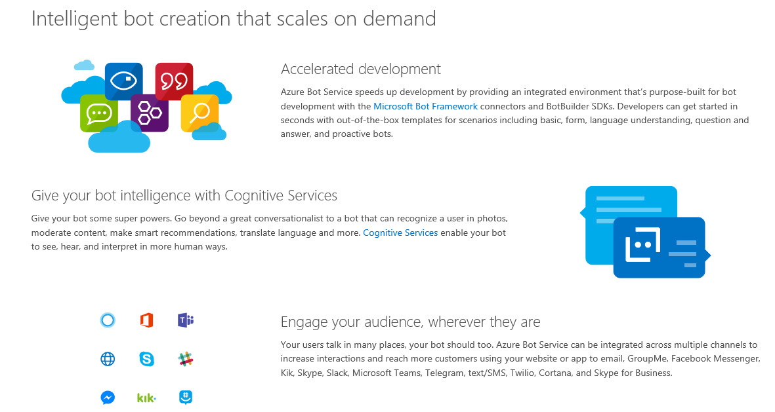
Azure Bot Services
This Microsoft Azure service allows for accelerated development of intelligent bot that can easily scales on multiple platform to reach its users.

Slide 4
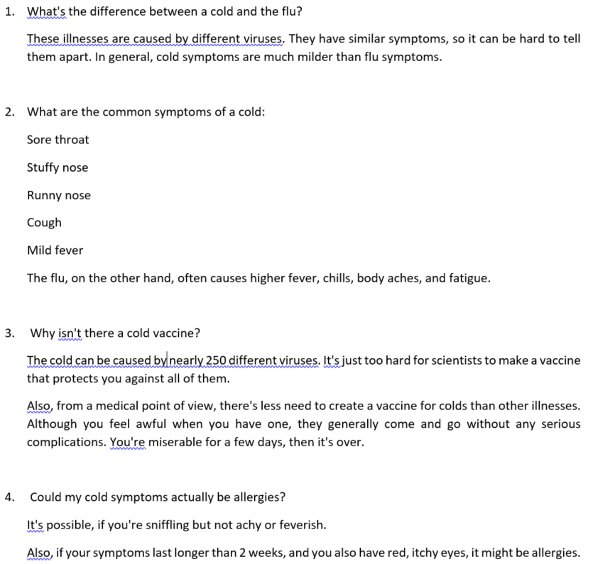
Data Set
Information about the Flu and Cold from the website:
https://www.webmd.com/cold-and-flu/top-10-questions-cold
Create a Word document with Questions and Answers

Slide 5
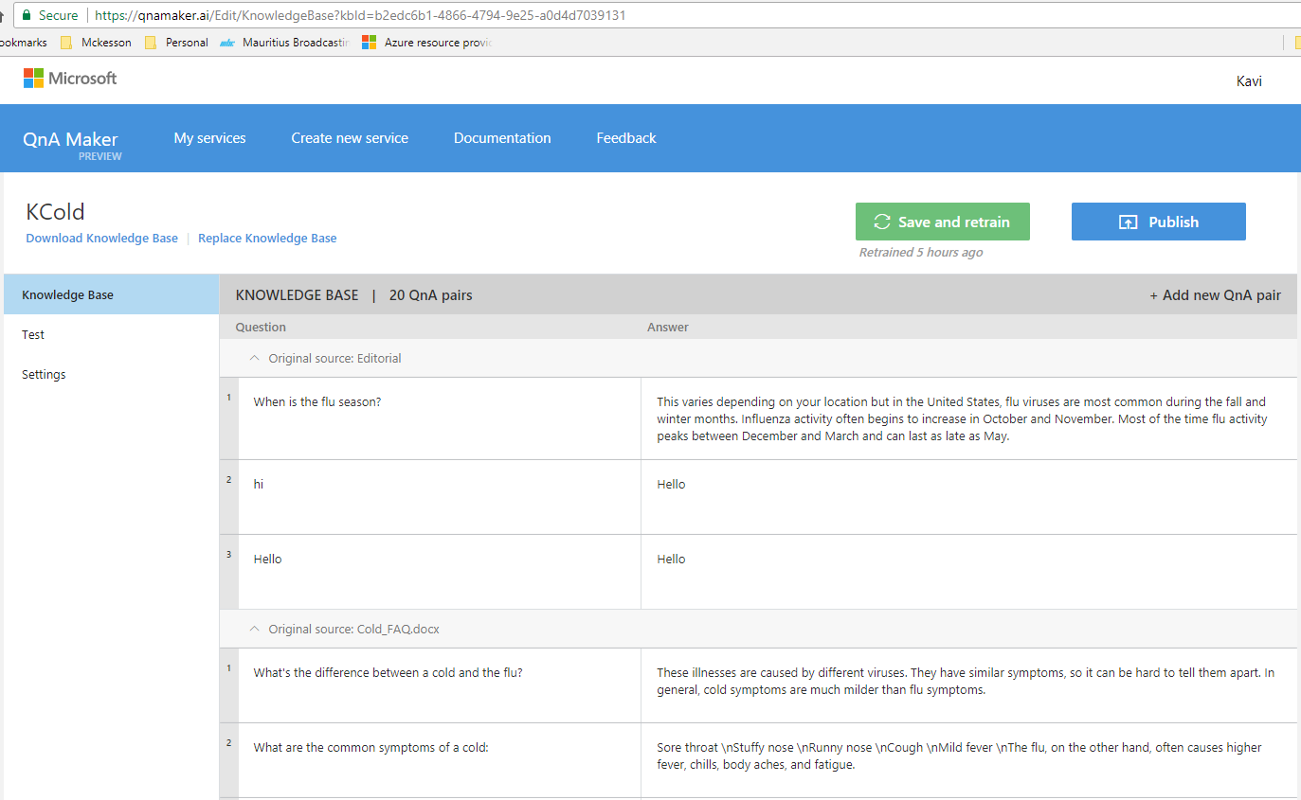
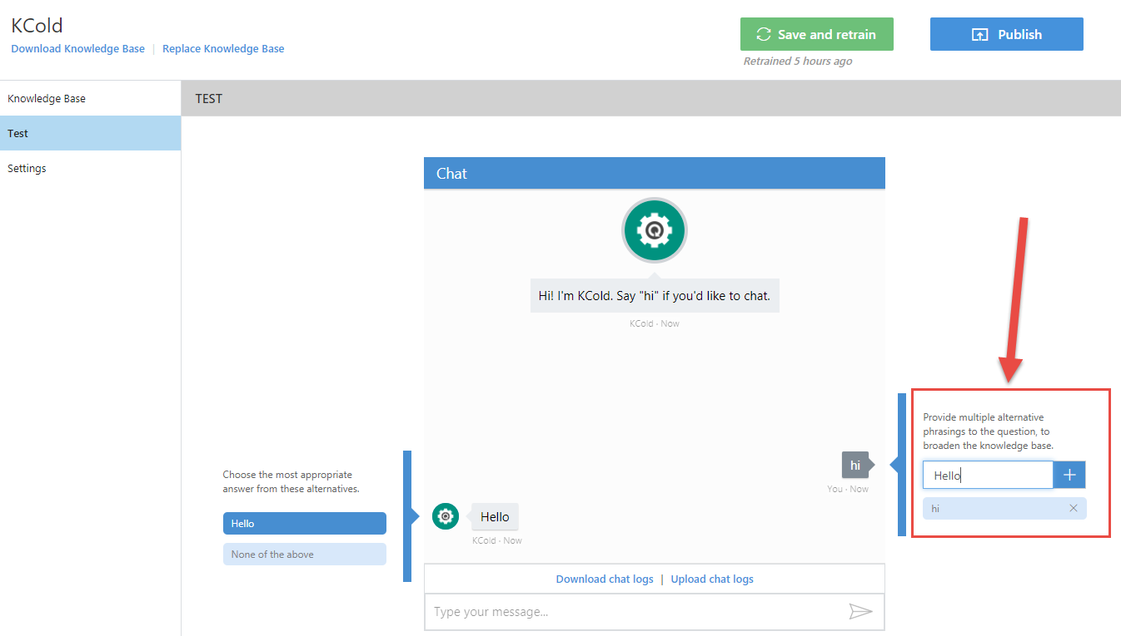
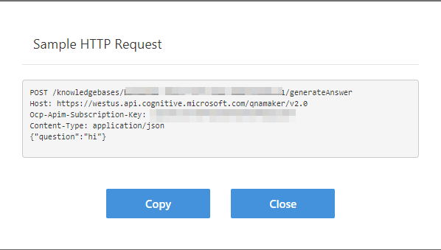
Azure Web Bot
Create QnA intelligence for Web Bot on https://qnamaker.ai

Slide 6
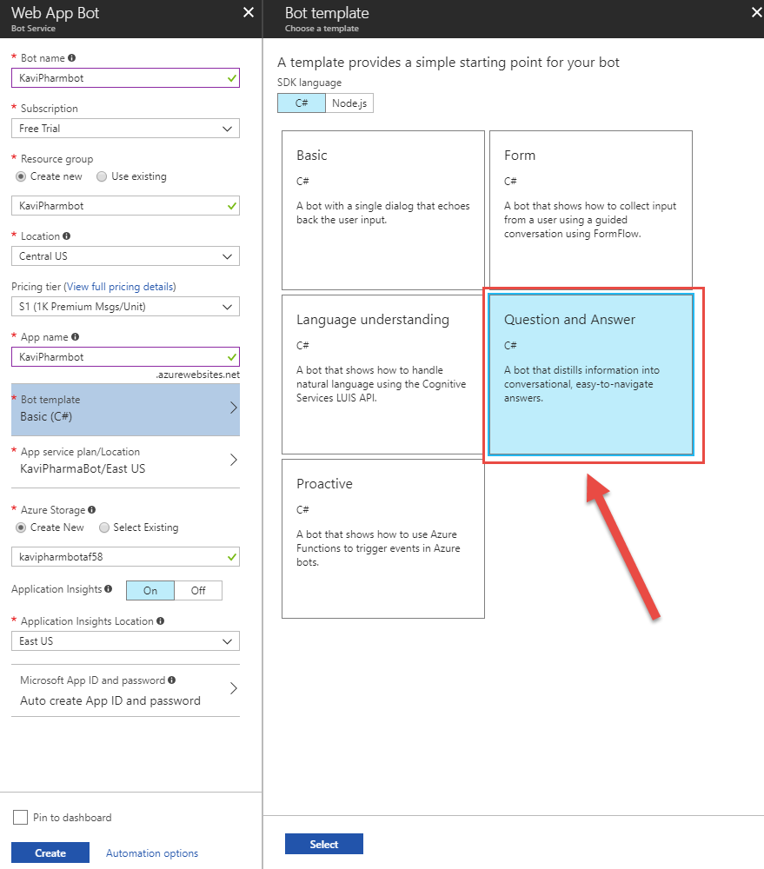
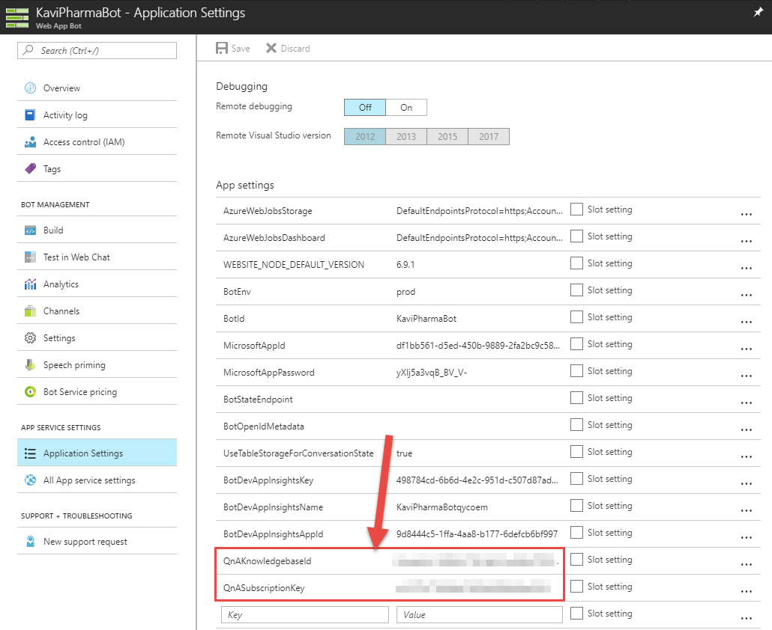
Azure Web Bot
Create Web Bot on Azure Portal and connect it to the QnA AI created before

Slide 7
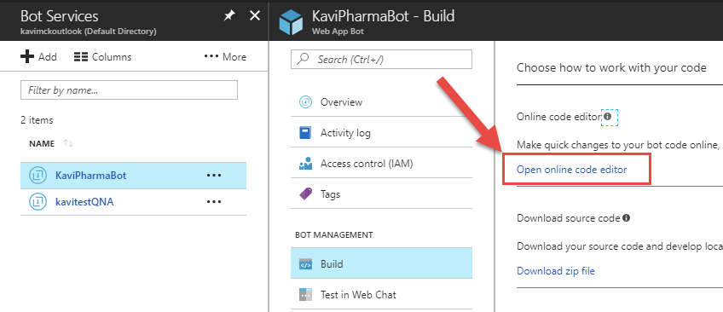
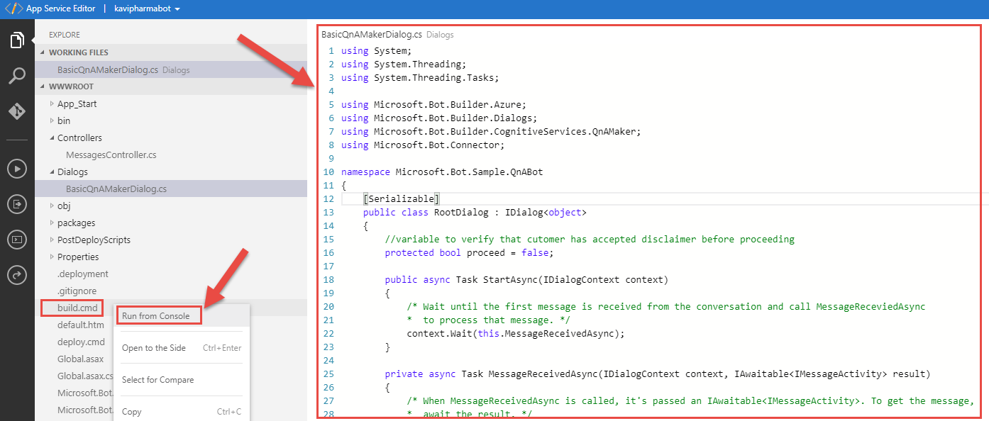
Customize Azure Web Bot
Modify Web Bot so that it presents its users with a disclaimer and upon acceptance of the disclaimer, the users can ask questions about the flu or the common cold.

Slide 8
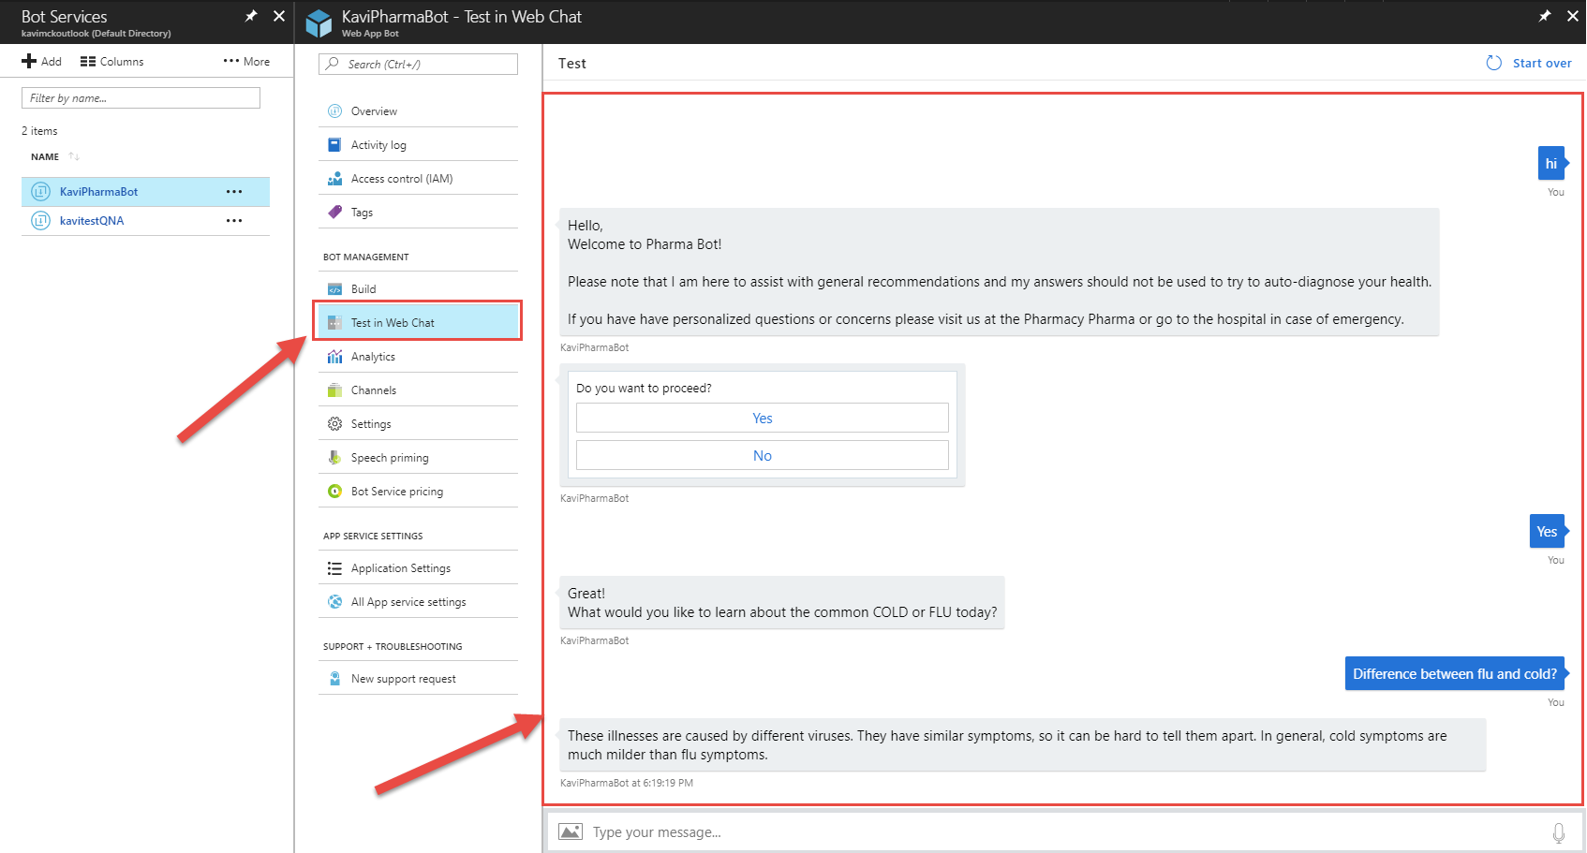
Testing Web bot
Simulate conversation with the bot

Slide 9
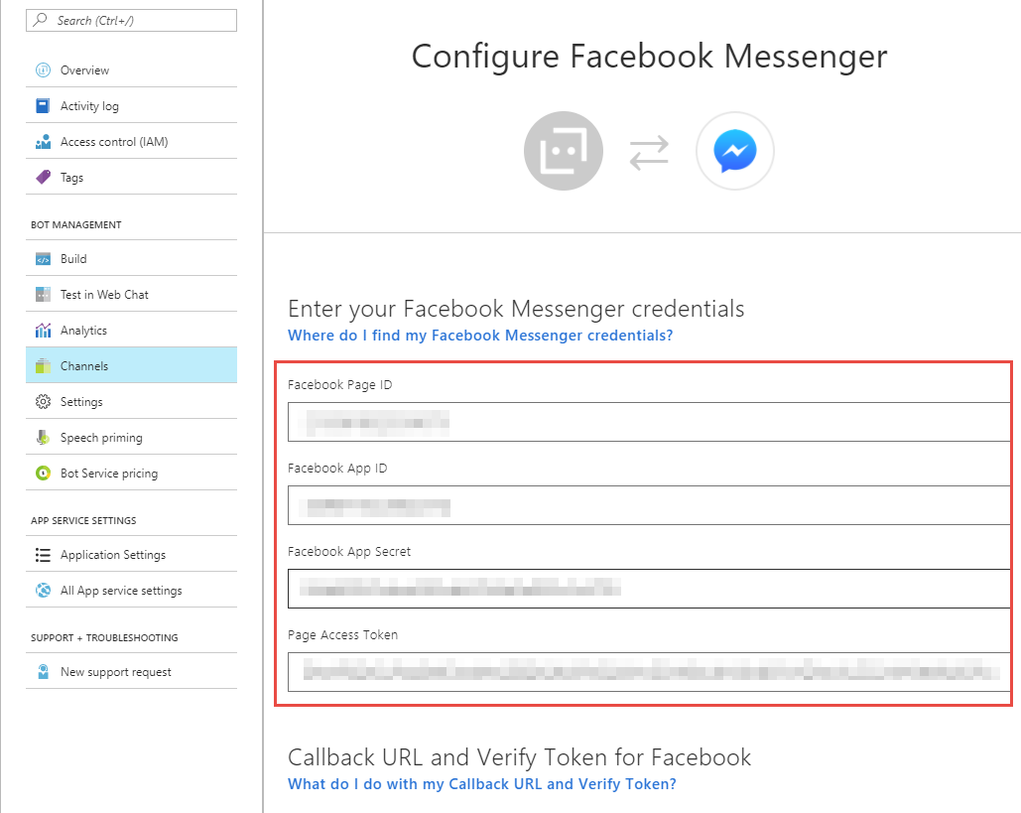
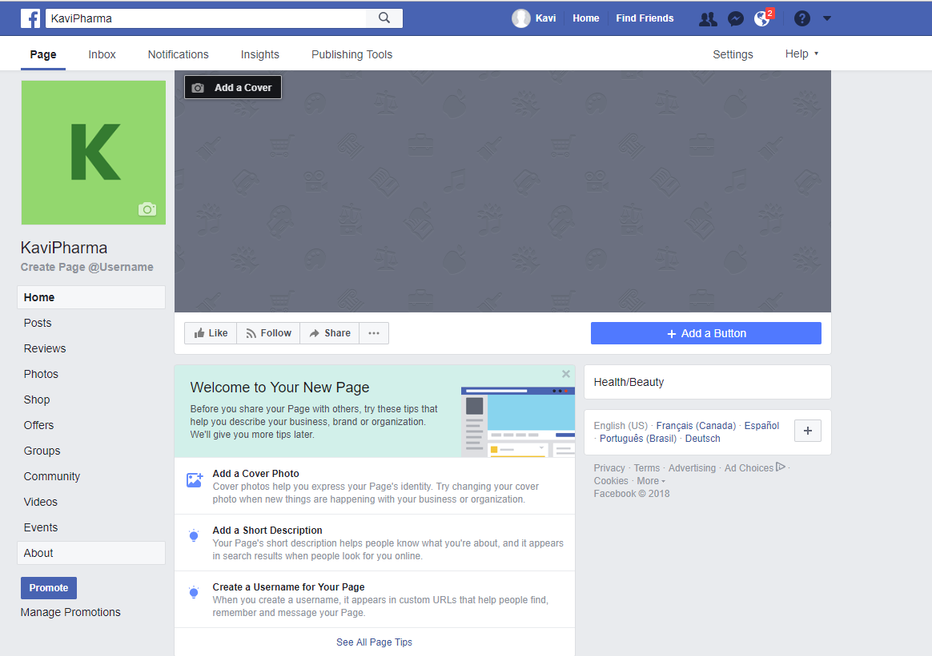
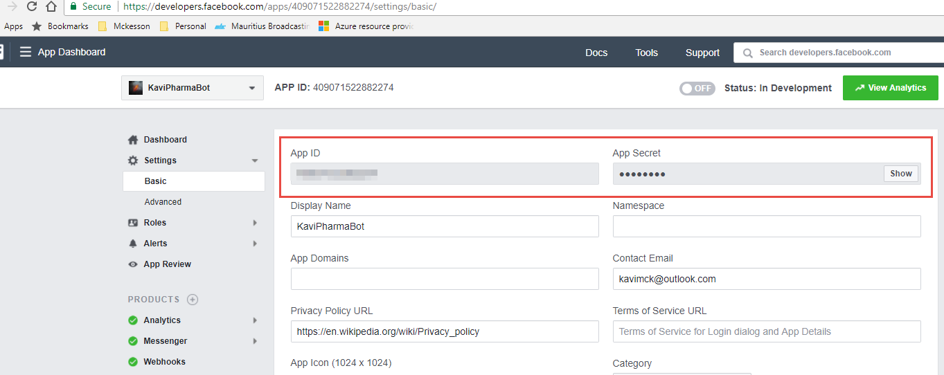
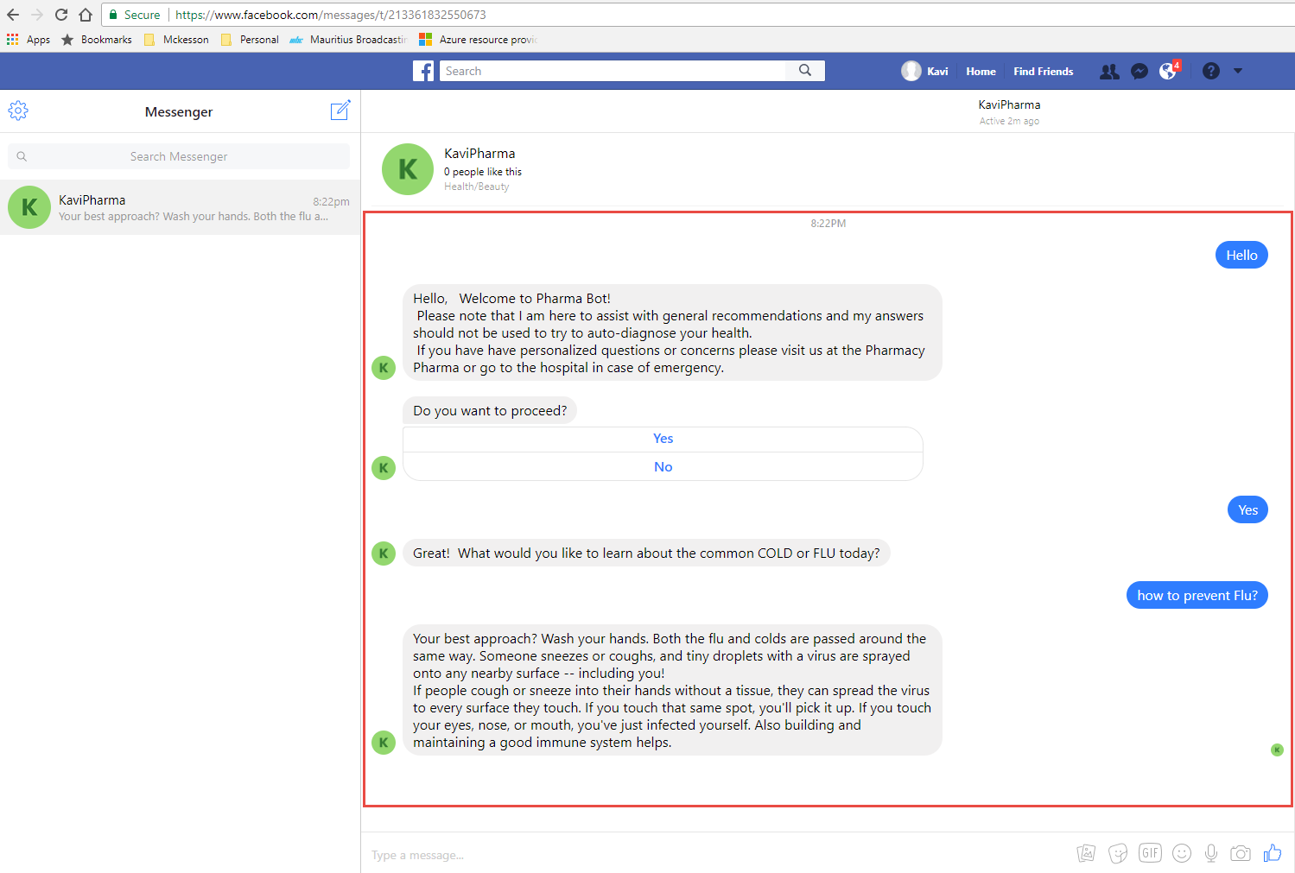
Connect Web Bot to Facebook Messenger
Create a Facebook page , App and then associate it with the Bot

Slide 10
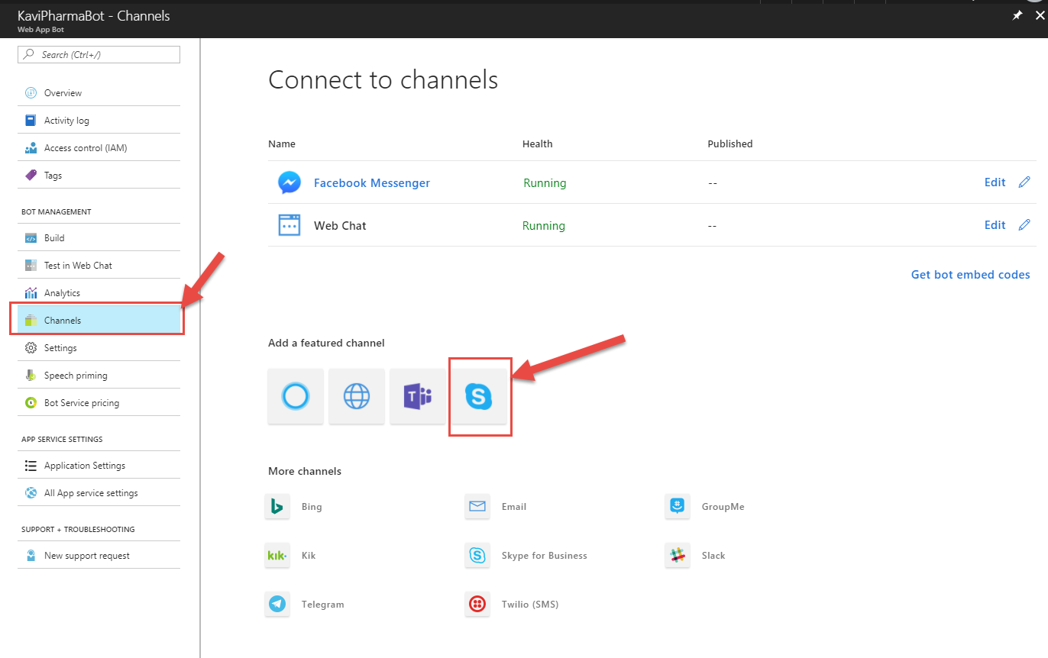
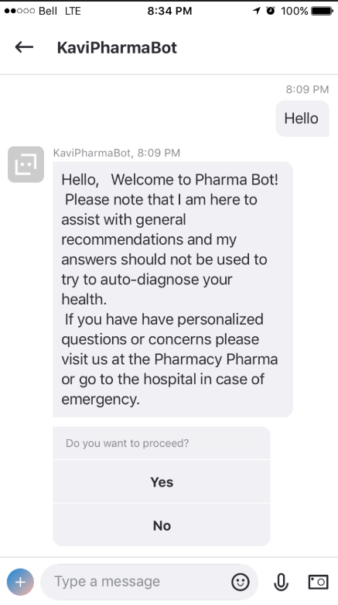
Connect Web Bot to Skype
Associate Web Bot to Skype

Slide 11
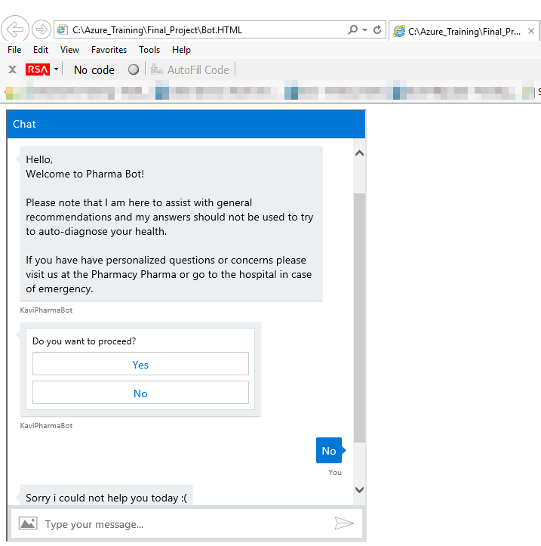
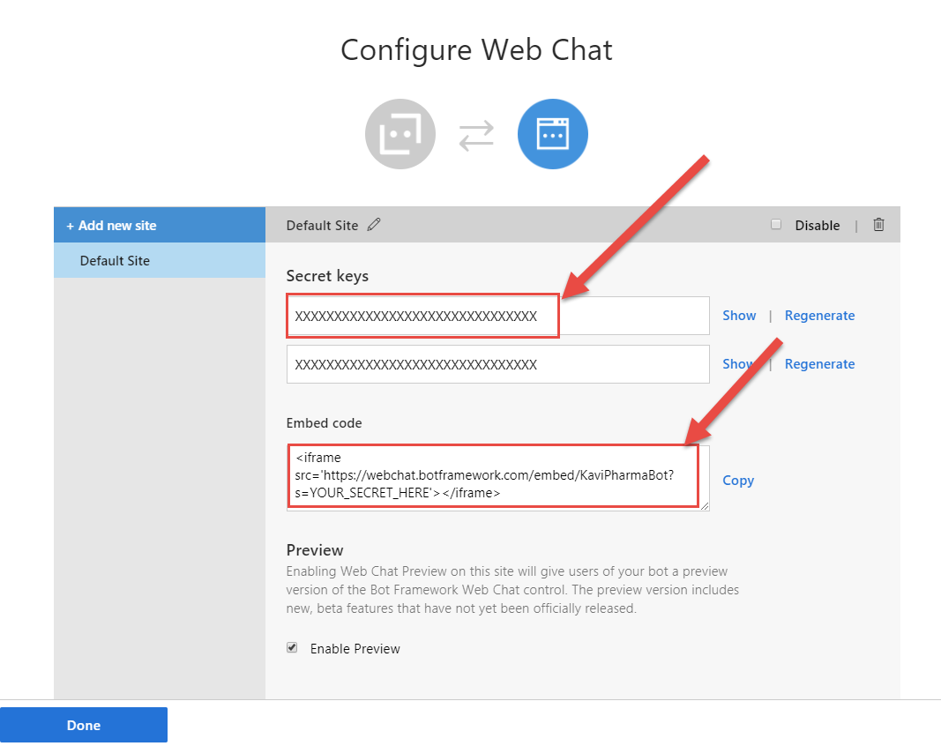
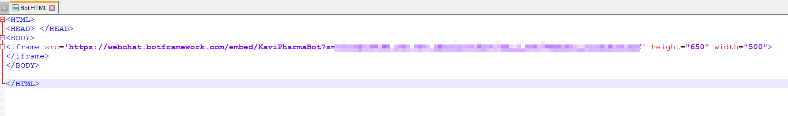
Connect Web Bot to Webpage
Associate Web Bot to a Web Page

Slide 12
Lesson Learned
Advantages of Azure Bot Services
The use of the bots is very flexible as it allows uses on multiple platforms to connect to it. This means that the users most of the time will not have to install a separate application only to communicate with the bot.
Allows users to ask questions and get a short answer as opposed to a huge article where the users need to search for the information they are looking for.
Allow developers to connect to multiple other Artificial Intelligence API such as FaceAPI, Speech API and LUIS
Disadvantages of Azure Bot Services
Users might be resistant to the speaking with Bots in the beginning.
While the Bot services allow connection to different platforms, this requiring monitoring the changes that will occur on the other platform to ensure that, the Bot Service on a specific platform is not affected.

Slide 13
YouTube URLs, GitHub URL, Last Page
Short Video:
https://youtu.be/H-TqfHbwMVE
Long Video:
https://youtu.be/m-7m0mIRagg
GitHub Repository with all artifacts:
https://github.com/kavishen/AzureFinal

